Slide 1

Interfacing Ultrasonic sensors with Beaglebone Black Wireless Project : IOT BASED SMART PARKING USING BEAGLEBONE BLACK WIRELESS
SUBMITTED BY:
MERLIN MARIAM THANKACHAN (C0748721)
Group #1

Slide 2
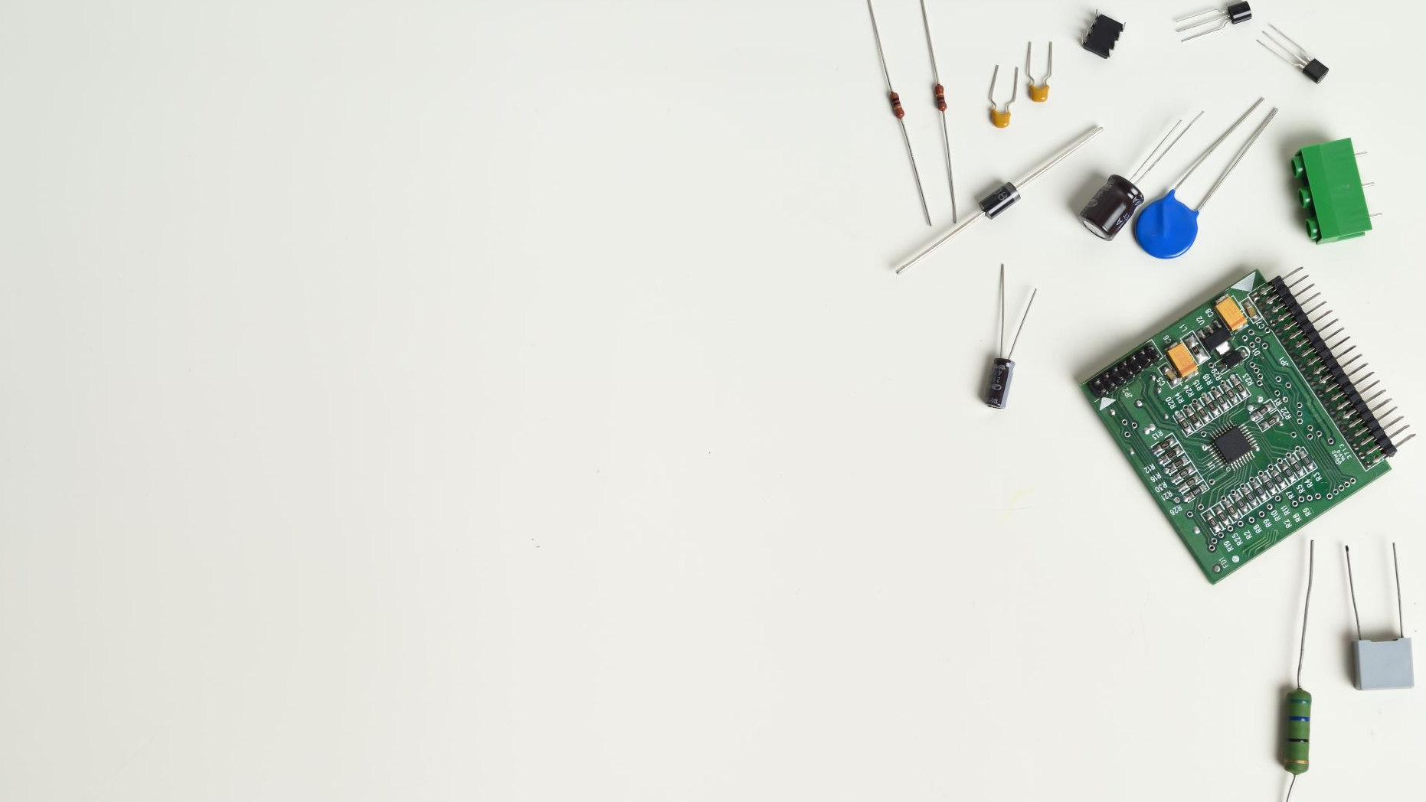
Contents
Introduction.
Interfacing Beaglebone Wireless with HC-SR04 ultrasonic sensor.
Connection details
Coding steps
Output
Hardware circuit
References.

Slide 3
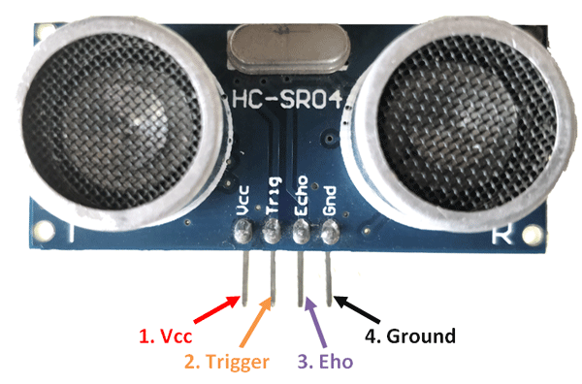
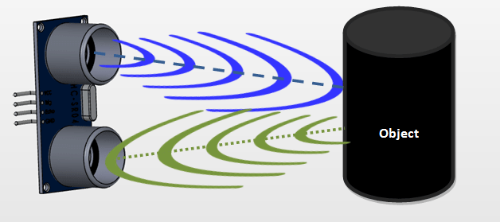
Introduction
HC-SR04 Ultrasonic (US) sensor is a 4-pin module, which having pins Vcc, Trigger, Echo and Ground.
Operating voltage is +5V and current is 15mA
The Trigger and the Echo pins are connected to I/O pins of the microcontroller
Ultrasonic sensor is used in this project to identify the presence of vehicle both at entrance and parking lot.

Slide 4
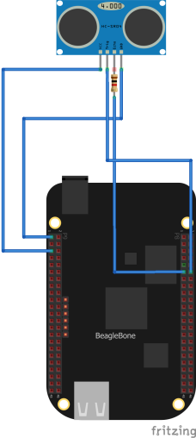
Interfacing Beaglebone Wireless with HC-SR04 ultrasonic sensor.
The HC-SR04 is a 5V device and the beaglebone is 3.3V device.
In order protect the beaglebone from the sonar a 1Kohm resistor is connected to echo terminal.
To trigger the ultrasonic, a high pulse should be provided for at least 10 microsecond.
Echo pin will be activated when the reflected pulse is received at the receiver.

Slide 5
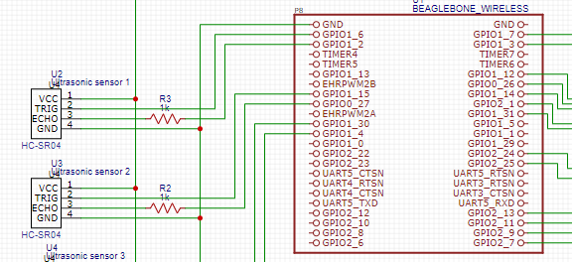
Connection details
Vcc pin of all sensors are connected to common VCC bus
Gnd pin of all sensors are connected to common GND bus
Trigger pins of sensor1, sensor 2, sensor 3 are connected to gpio66, gpio69, gpio60 respectively
Echo pins of sensor1, sensor 2, sensor 3 are connected to gpio67, gpio68, gpio48 respectively through a 1kohm resistor

Slide 6
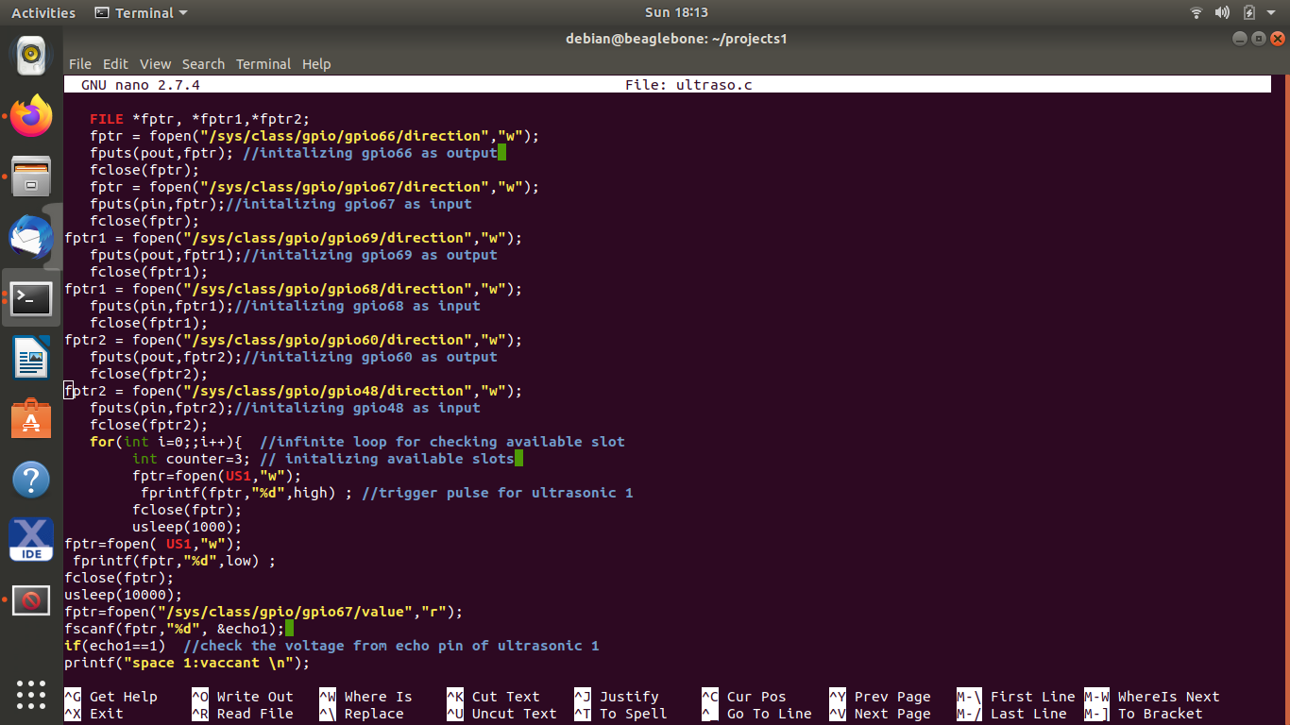
Coding steps
Define the gpio pins as output pin for trigger by opening direction file as writable and adding “out” using “fputs”
Define the gpio pins as input pin for echo by opening direction file as writable and adding “in” using “fputs”
A counter is set for counting the slots available.

Slide 7
Contd…
In order to trigger sensor, open value file of the gpio of trigger pin as writable the add “1” for high.
Delay is added using “usleep” function
open value file of gpio as writable the add “0” for low.
To read the voltage from echo pin, open value file of corresponding gpio as readable and read data using “fscanf”

Slide 8
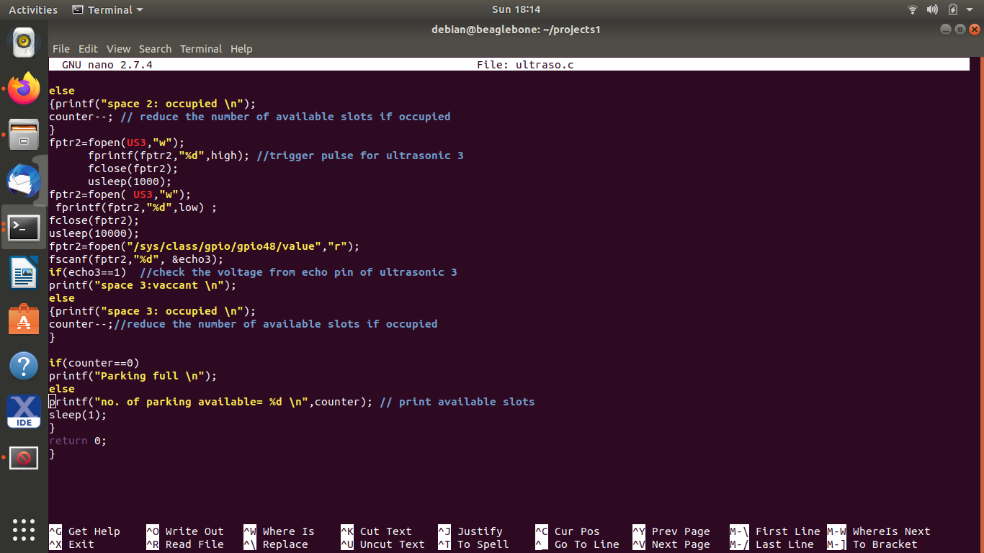
Contd…
When the slot is occupied the counter will be decremented
Finally check the value of counter and if its 0 the “parking full” will be printed
Otherwise number of available slots will be printed based on the value of counter.

Slide 9
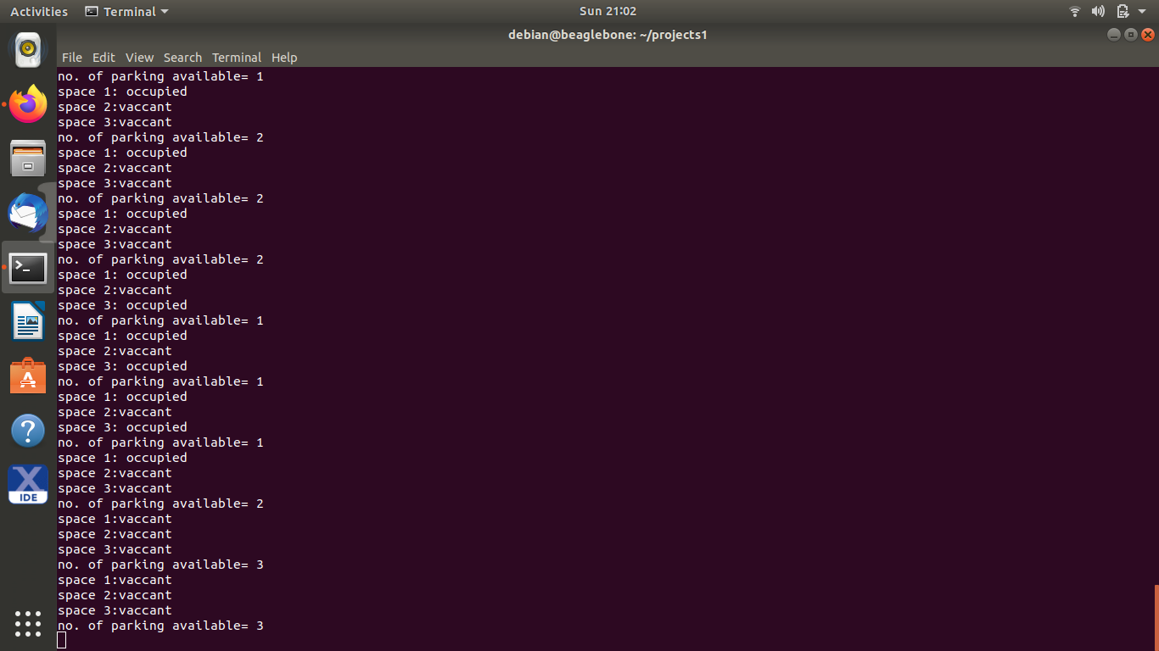
Output

Slide 10
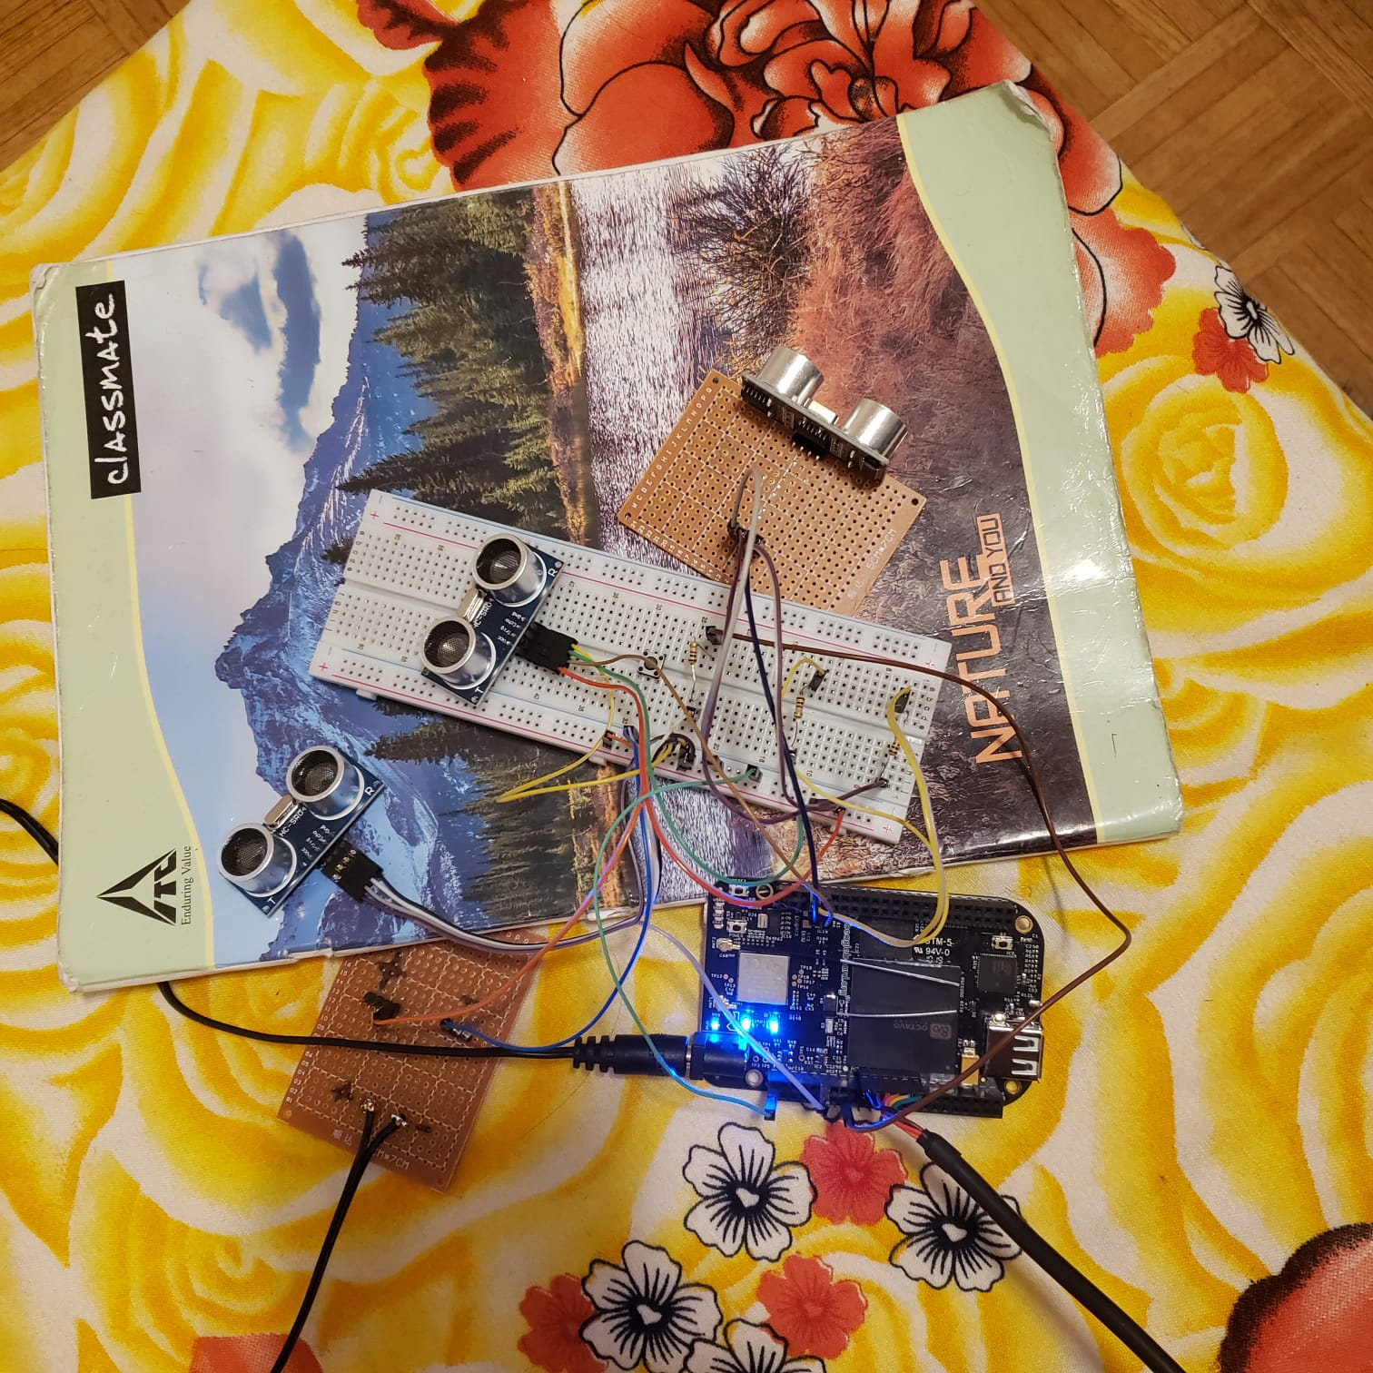
Hardware Circuit

Slide 11
REFERENCES
Component101 (2017 Sep). HC-SR04 Ultrasonic Sensor retrieved from
https://components101.com/ultrasonic-sensor-working-pinout-datasheet
Teknoman117(2013 April) , Using a Beaglebone with an HC-SR04 sonar, retrieved from :
https://teknoman117.wordpress.com/2013/04/30/using-a-beaglebone-with-an-hc-sr04-sonar/

